Slide 1



Slide 2
ADMISSION PREDICTION
Using Machine Learning Techniques
Guide : Sameer Warsolkar
Presented By : Asif Shaikh
Institute : IT Vedant
Course : DS&DA
Branch : Thane

Slide 3
Steps
Define the Problem(Problem Statement: Regression.
Data Loading.
Exploratory Data Analysis(EDA):-
Identification of variables and data types.
Graphical Univariate Analysis
Missing value treatment
Seperation of x and y
Train Test Split
Choose a Model
Train the Model
Evaluate the Model
Model Deployment

Slide 4
Problem Statement
University Admission Prediction :-
University education is becoming a critical pillar of social and economic life in the twenty-first century.
It is crucial not only in the educational process but also in assuring two vital things:
A great job and financial stability.
Predicting university entrance, on the other hand, might be extremely challenging because pupils are unaware of the admission standards.

Slide 5
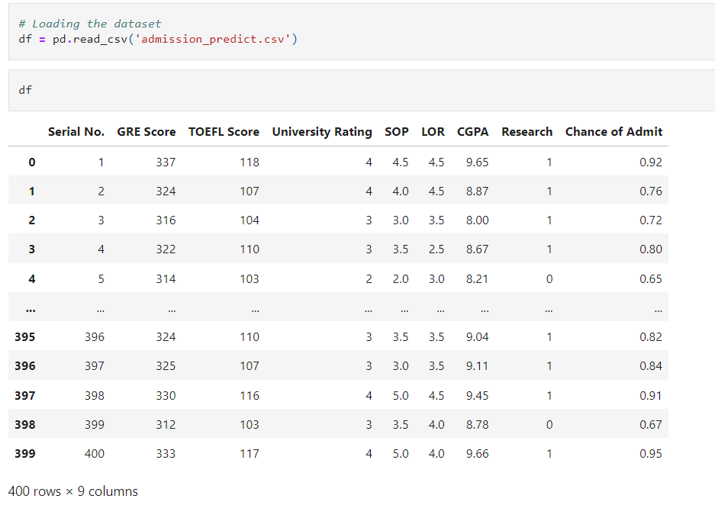
Data Collection

Slide 6
DATA DICTIONARY
Serial No: Numbers wise
GRE Score: Graduate Record Examination
TOEFL Score: Test of English as a Foreign Language
University Rating: University Rating is based on various criteria
SOP: Statement of Purpose
LOR: Letter of Recommendation
CGPA: Cumulative Grade Point Average
Research: Research is conducted with a specific purpose or goal in mind
Chance of Admit: An individual will be admitted to a particular academic program, institution, or job position

Slide 7
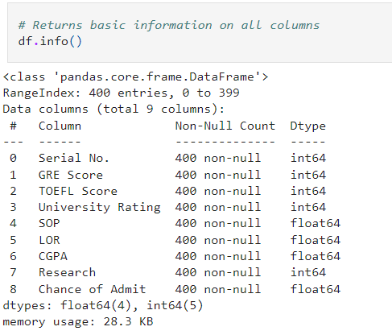
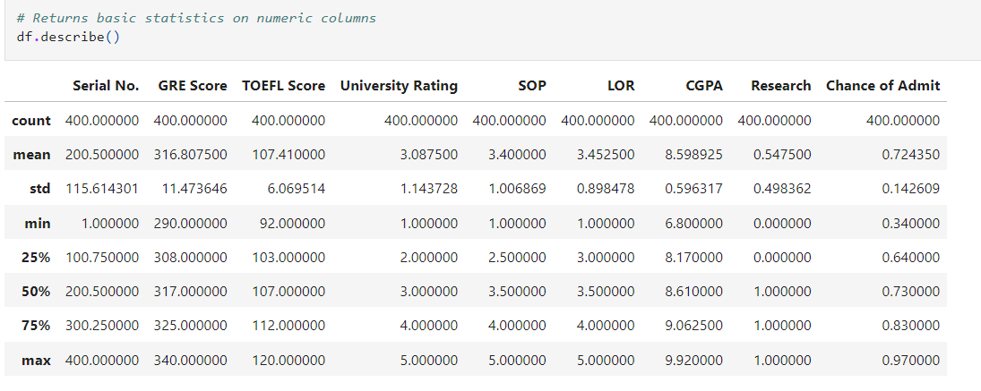
EDA
Identification of Varialbles and data types
Non-Graphical Univariate Analysis

Slide 8
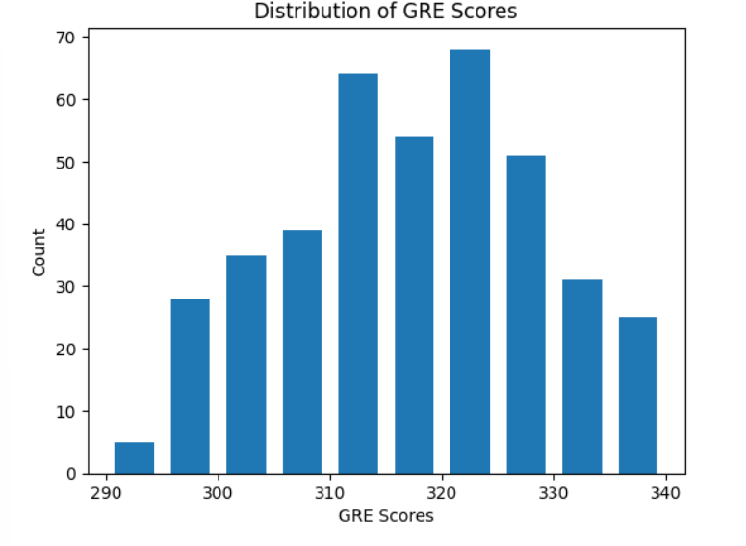
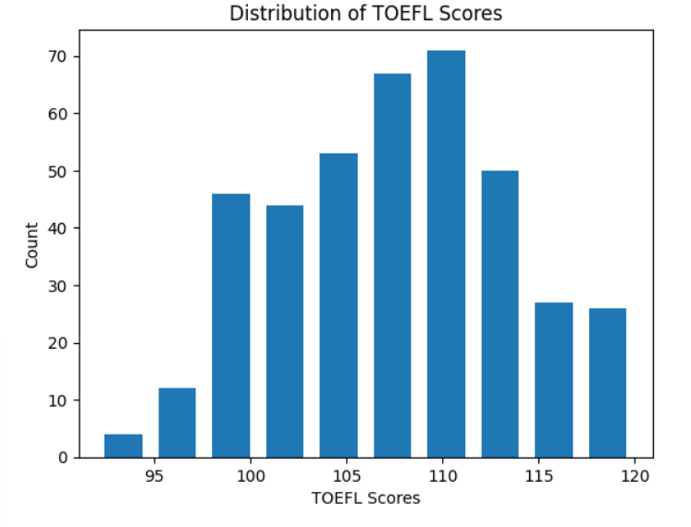
Graphical Representation
Distribution of GRE Scores
Distribution of TOEFL Scores

Slide 9
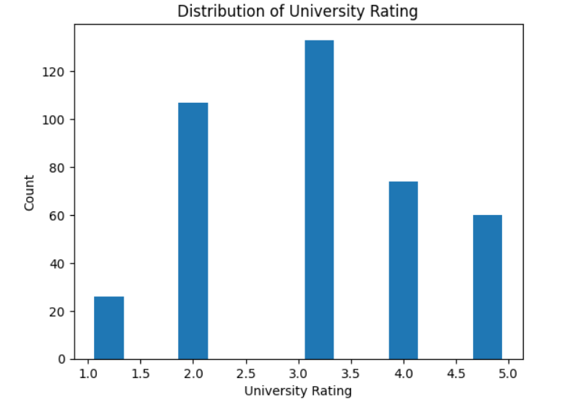
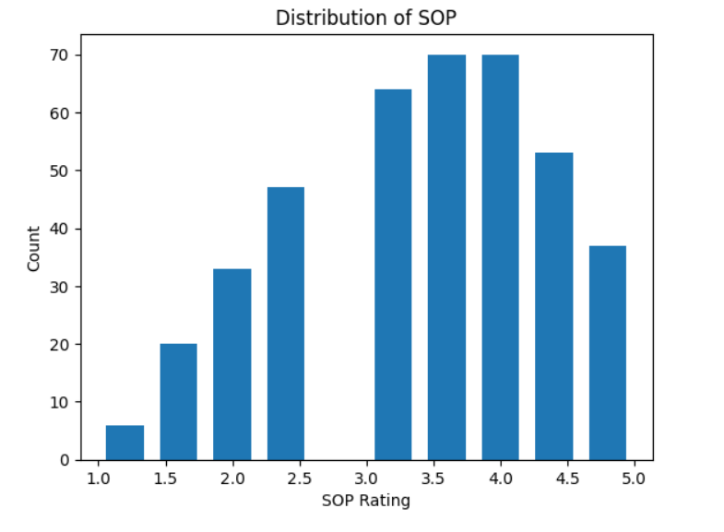
Distribution of University Rating
Distribution of SOP Rating

Slide 10
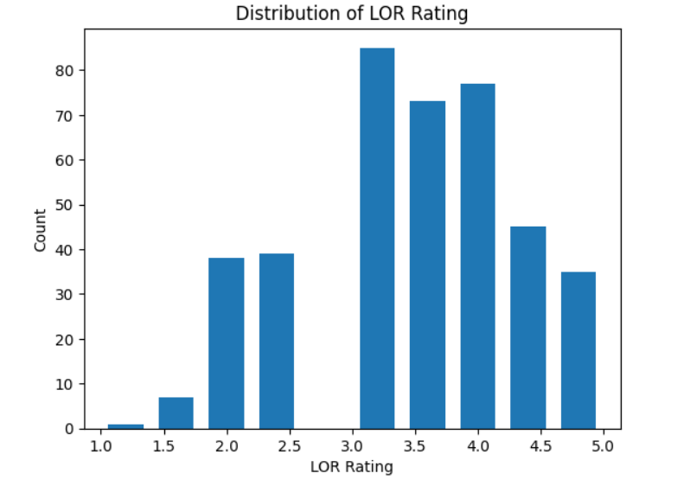
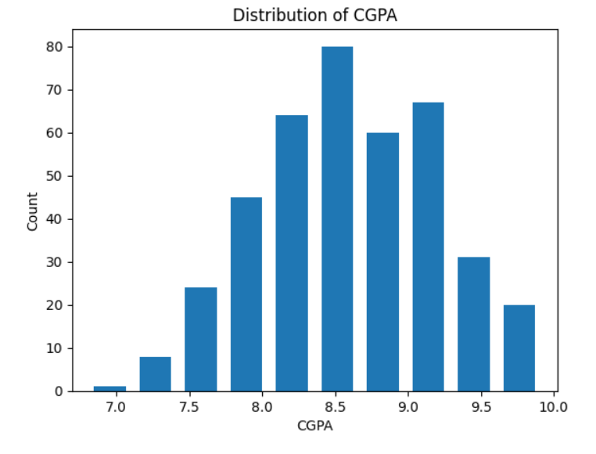
Distribution of LOR Rating
Distribution of CGPA

Slide 11
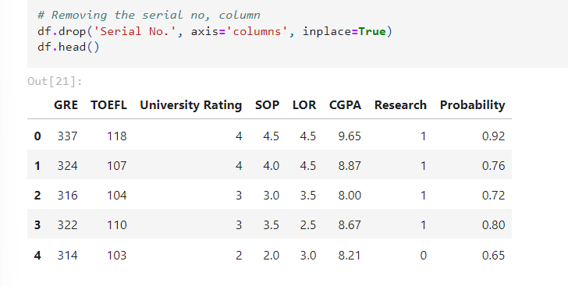
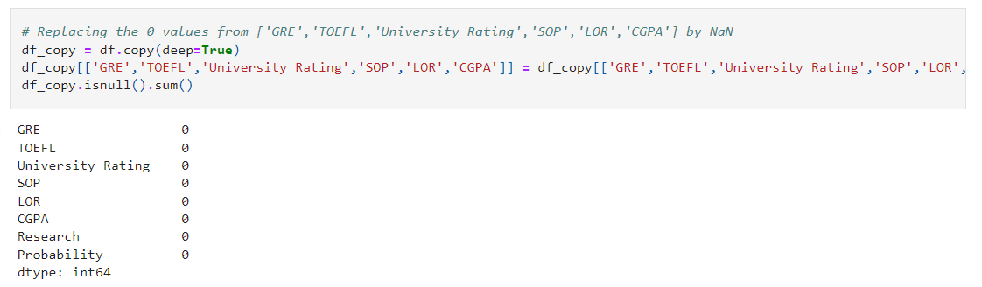
Data Cleaning

Slide 12
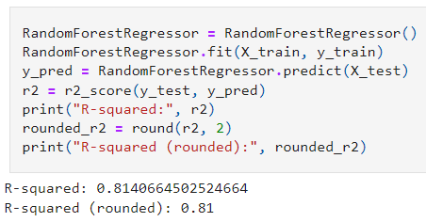
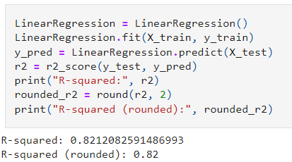
MODEL BUILDING
RandomForestRegressor
LinearRegression

Slide 13
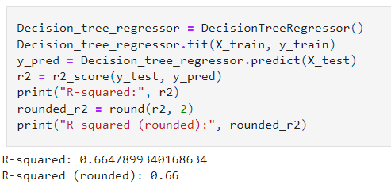
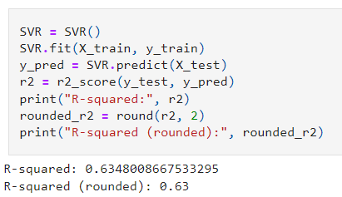
Decision_tree_regressor
SVR

Slide 14
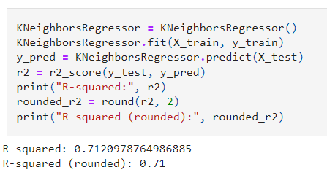
KNeighborsRegressor

Slide 15
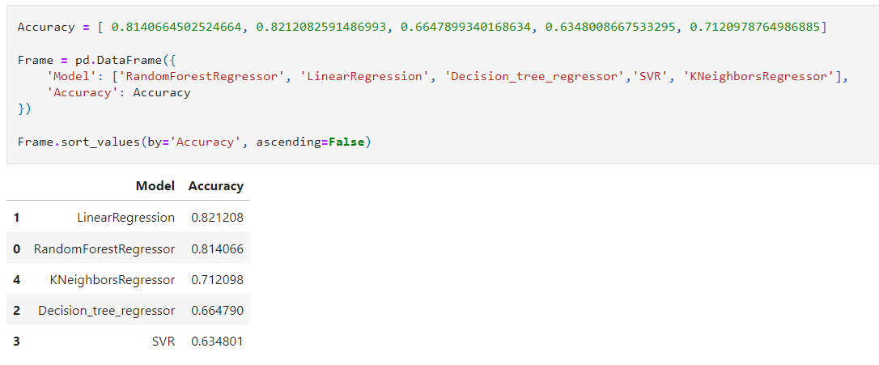
ALL MODEL IN ONE DATAFRAME

Slide 16
CONCLUSION
The order of the Best Models Accuracy from top to bottom is : LinearRegression

Slide 17
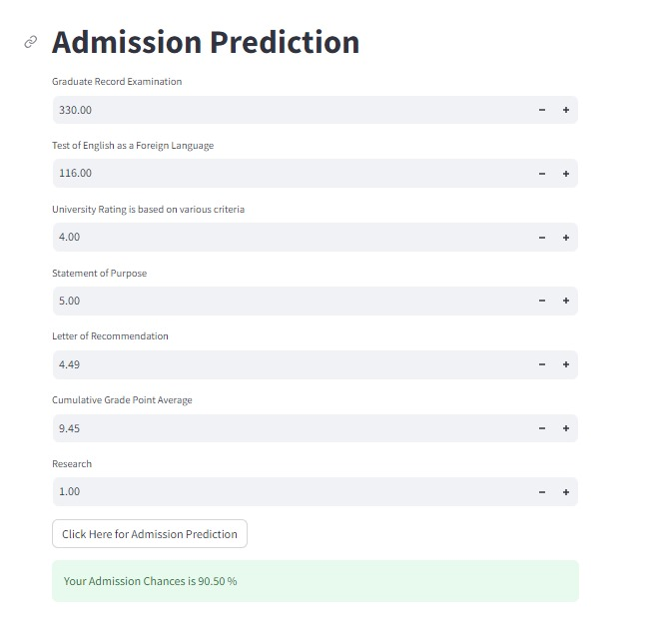
DEPLOYMENT
Tools and Libraries used-
Anaconda Navigator : Environment Creation
Pickle : Binary Conversion of data
Stream lit : Web App
Scikit-Learn : Linear Model

Slide 18


